Slide 1
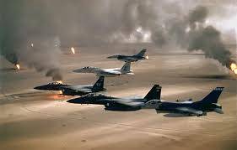
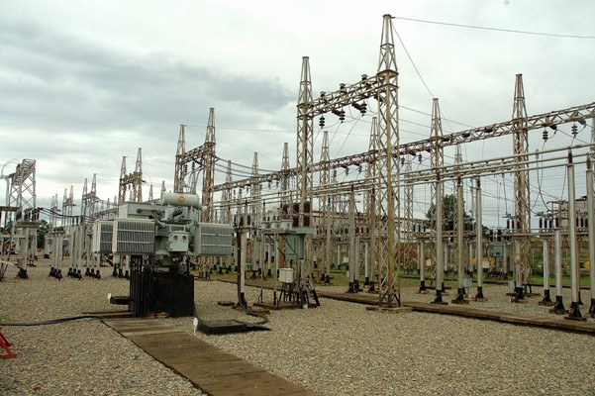
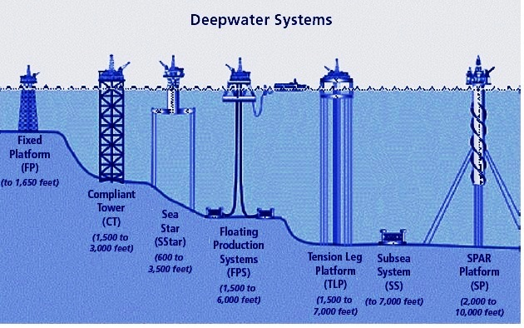
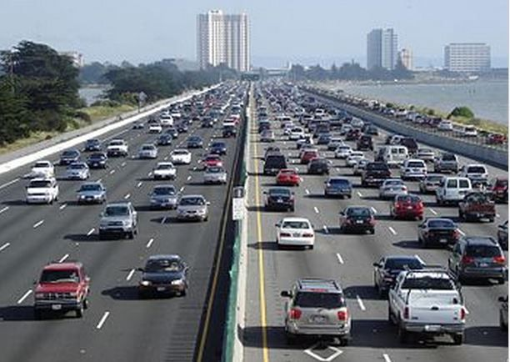
A National Energy Program
Treating Energy as a Matter of National Security to Avoid Chaos
Overview of NEP white paper http://www.ourenergypolicy.org/a-national-energy-program-the-apollo-program-of-our-time/
Presentation at:
The UN Foundation
August 12, 2015
Presented by:
Lawrence Klaus
Revision 5: 08/19/15

Slide 2
Presentation Outline
What Is The Goal
When Will We Achieve it?
Why Should We Achieve the Goal? To Avoid Chaos
How Will We Achieve the Goal? Use Methods Proven “At Scale”
How Will NEP Operate?
How Do We Start? NEP Planning Project
How Will We Educate Leaders Able To Solve Today’s Problems?
2

Slide 3
“What” Is The Goal: “When” Will We Achieve it?
To eliminate the gap between U.S. oil consumption and production and reduce green house gas emissions in a decade as a milestone on the road to a sustainable energy future.
  Six million barrels of oil a day - High end of EIA, IEA forecasts for 2025
    Natural gas plentiful. Eliminating the “oil gap” = energy independence
  1,300 million metric tons of CO2 equivalent by 2025
    Goal and timeline set by Barak Obama and Xi Jinping at APEC summit
  Oil, emissions timelines made coterminous to facilitate joint planning
It’s not just about us!
  Our security and stability is becoming inextricably linked to security and stability elsewhere in the world - DOD 2013 National Security Strategy
  America must lead by example to induce other energy consuming nations to become less dependent on energy from unstable and unfriendly nations
Use methods proven “at scale”
  “Apollo like” program planning and management to achieve goal
  Supply chains built during program position U.S. for sustainable future
  NEP planning project prepares a NEP plan available in time to impact new administration coming into office
  Methods used in national security matters

Slide 4
The Goal is a “Milestone” on the Road to a Sustainable Future
NEP isn’t a “one shot deal” like Apollo
Reliance on fossil fuel is fueling our environmental demise
Must start down road to reduce carbon loading of atmosphere faster
Additional use of fossil fuel during “NEP decade” must be emissions neutral
Oil gap and Emissions
Reduction 0
>= 6 MBD
>= 1300 MMT
Energy Products,
Efficiency and Supply Chains
Oil Gap and Emissions
0 Years
10 Years
Time
20 Years
NEP isn’t a “Zero Sum” game
Fossil fuel and green energy interests make tradeoffs during
planning process to resolve differences and secure buy in.

Slide 5
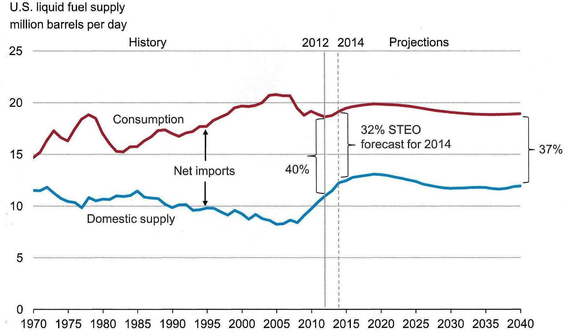
Projected Oil Gap 4-7 MBD in 2025 – IEA,EIA
Business as usual forecasts oblivious of world events
Risk of supply disruptions, energy crises, conflicts not considered
  Velocity in instability is ever increasing around the world
  - General Raymond Odierno, Army Times
Set goal at higher end (“at least” 6 MBD) to cover “downside risk”
  Oil gap, emissions objectives and timeline set as floor not ceiling
U.S dependence on imported liquids depends on both supply and demand
Source: EIA annual energy outlook 2013

Slide 6
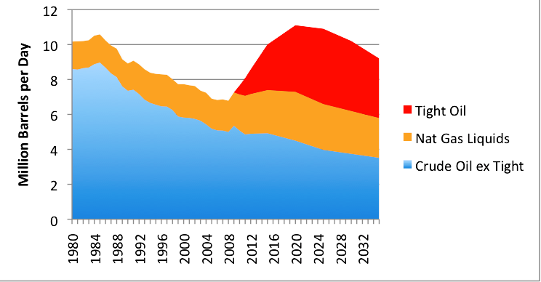
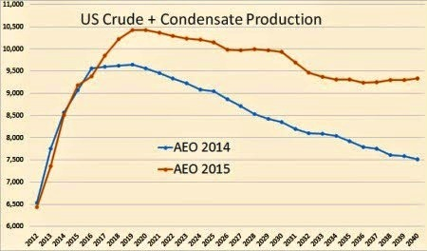
Short Term Energy Euphoria Ignores Long Term Reality
US and global weak demand and low gas prices reflects unstable conditions, deflationary pressures and rout in commodities
Euphoria
More oil produced at home than we buy from the rest of the world – the first time that’s happened in nearly 20 years … The all-of-the-above energy strategy I announced a few years ago is working, and today, America is closer to energy independence than we’ve been in decades
- President Barak Obama, 2014 State of the Union Address
Reality
IEA, EIA forecast U.S. oil production will peak by 2020 then decline without achieving energy independence.
Frontload activity to avoid being overtaken by unforeseen events again
IEA Forecast of US Oil Production, 2012
6
EIA Early Release Annual Energy Outlook, 201

Slide 7
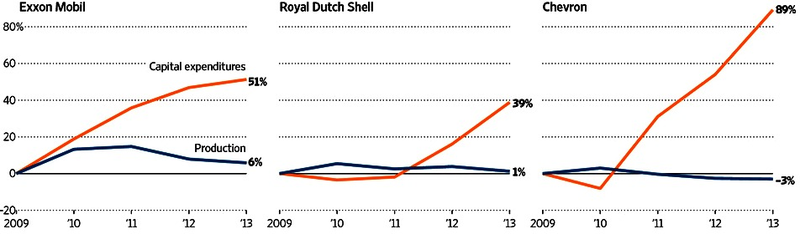
Global Production Won’t Eliminate the Oil Gap
Global energy demand projected to increase one third from 2011-2035 - IEA WEO 2013
World’s major oil companies all suffer from some version of the same problem: spending more money to produce less oil. The world’s cheap, easy-to-find reserves are basically gone; the low-hanging fruit was picked decades ago. The new stuff is harder to find, the older stuff is running out faster and faster.
- Bloomberg Businessweek, “Big Oil Has Big Problems”
Costly Quest
Exxon, Shell and Chevron have been spending at record levels as they seek to boost
their oil and gas output. It has yet to pay off. Below, change in production since 2009
Source: the companies, reflects company 2013 estimates. - WSJ
If global economy doesn’t revive, oil glut will be least of our problems

Slide 8
    Why Should America Achieve the Goal?
    Must treat energy as a matter of national security to avoid chaos
“Arc of instability” from North Africa to Southeast Asia [the region] could become an “arc of chaos” involving forces of many nations
- DOD 2010 Joint Operating Environment Report
  Seven of top ten nations with largest oil and gas reserves in the region - EIA
  We have a losing record in conflict in the region since WWII
  Implications for future combat are ominous, should nations see the need to militarily secure energy resources - JOE 2010
As our armed forces grow smaller, withdraw to the periphery and “pivot to Asia” our ability to defend the oil supply diminishes accordingly
  Countries with high performance weapons develop capabilities to deny access into their countries and theater energy supplies [A2/AD] - JOE 2010
  While the armed forces will grow smaller, it is less likely their operational tempo will decrease - Capstone Concept for Joint Operations: Joint Force 2020, Joint Chiefs of Staff
Relationships between non-state and state actors provide numerous benefits to both - Terrorist-Criminal Pipelines and Criminalized States: Emerging Alliances, NDU
  Eliminate oil addiction to drain money from states and non-state actors they support and threats will diminish accordingly

Slide 9
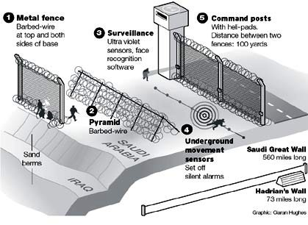
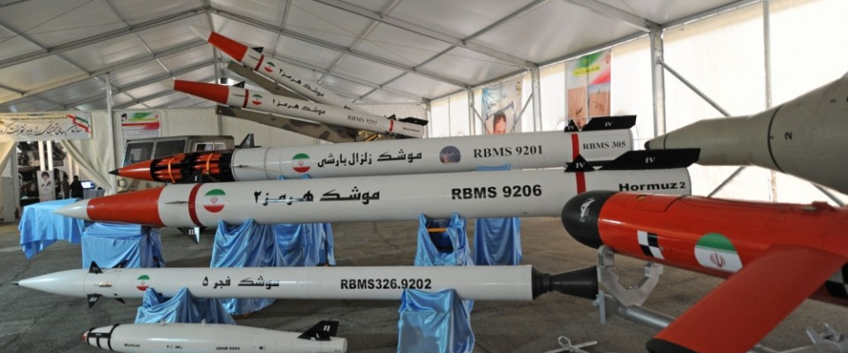
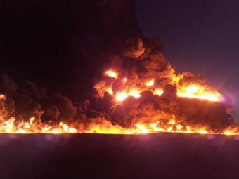
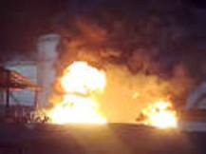
We Can No Longer Consider The Oil Fields Safe
Where an increase in terrorist activity intersects energy supplies the need for immediate action may require significant conventional capabilities - JOE 2010
If proxy wars turn into regional war key energy facilities impacting oil market and global stability will be at risk.
Future Stability Of Saudi Arabia Not Assured.
Saudis trying to finish new border fence and then slam
shut the gates as Yemen collapses - Reuters
Fire at Libya’s biggest oil terminal destroys 1.8 million barrels of oil - Reuters
ISIL blamed for new strikes aimed at crippling Libya oil production, rather than capturing it - WSJ
ISIL fighters set Iraq's Beiji oil refinery ablaze - Al Jazeera
9
What has to blow up before our leaders get it?

Slide 10
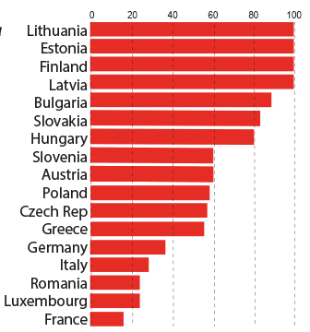
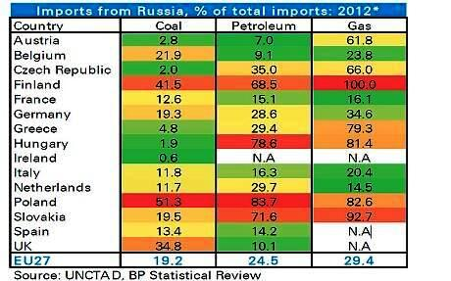
Power Shifts to Energy Producers With Different Interests
Europeans invading Russia have frozen in the dark
E.U. imports about 30% of its crude oil, gas and hard coal from Russia - Eurostat
  Countries closer to Russia’s border import energy at a much higher rates
  Lifting ban on U.S. oil exports doesn’t help Eastern European countries decrease reliance without building pipelines from ports to refineries - Reuters
  Russia’s strategy of buying up European oil refineries could compromise the bloc’s energy security [and ours] - EurActiv.com
  Mismatch between requirements of the world’s consumers and refineries’ capabilities
  US sends diesel to Europe. Europe sends gasoline to US - Global Refining Capacity, The Oil Drum
Gas supplied by Russia
Percent of total 2012 Source: Eurogas
Some European nations import 80-90%
of their energy needs from Russia

Slide 11
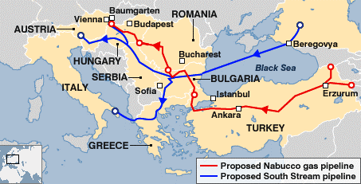
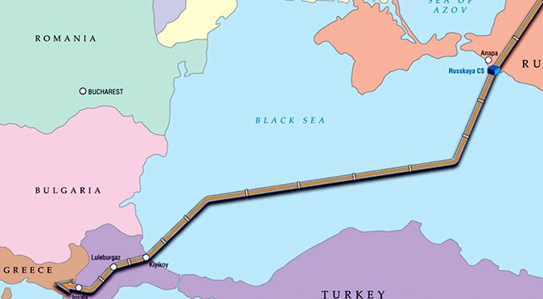
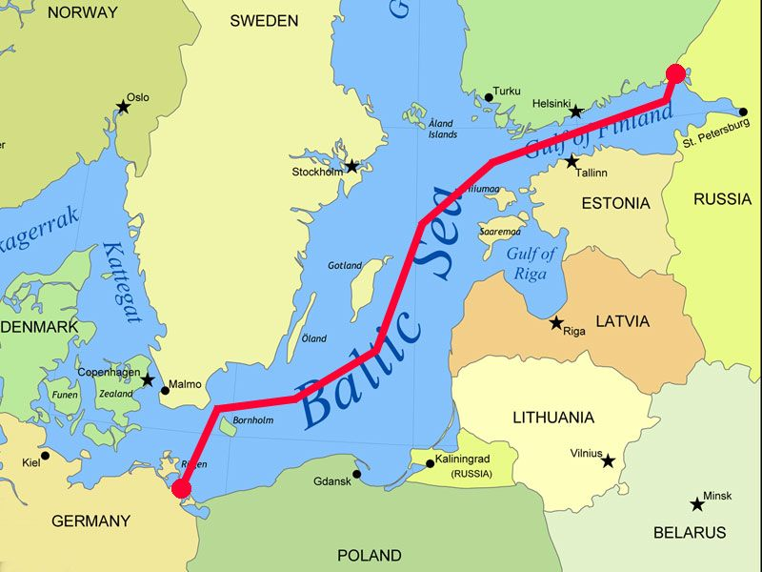
Control of Pipelines Shifts Power to Nations with Different Interests
Russia divides to conquer
Greece and Russia sign MOU extending planned Turk Stream pipeline to Europe through Greece, with financing from Russia - Bloomberg.com
South Stream and Nabucco gas pipelines
South Stream won competition with EU and American supported Nabucco. EU changed the rules
Turk Stream to bypass Ukraine
Russia to halt gas shipments across Ukraine to Europe when transit contract ends in 2019 - Bloomberg.com
Russians building
Kerch Strait bridge
Gazprom to build new
Nord Stream-2 gas pipeline under Baltic Sea to Germany by 2020 with E.ON (Germany’s largest utility), Shell, OMV.
- Reuters
E.ON argues that Europe's demand for Russian gas will grow as domestic production declines to 185 BCM by 2030 from 275 BCM in 2010

Slide 12
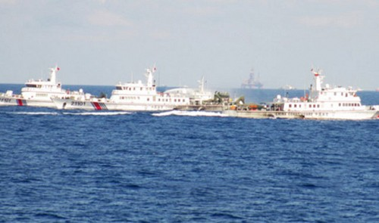
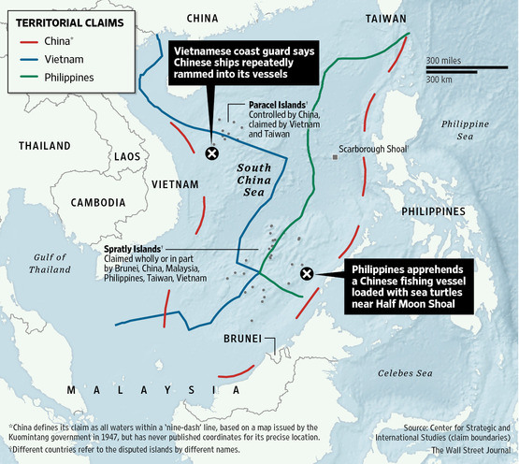
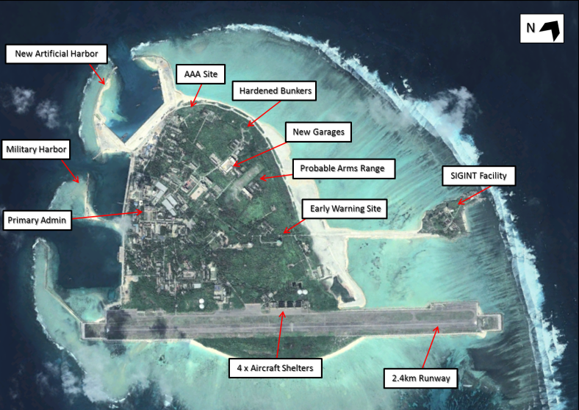
Is America’s “Pivot to Asia” really a Pivot to a New Energy War?
China rapidly expanding offshore oil fleet – adding coast guard vessels to protect it – as it ventures farther into the sea, threatening more altercations with neighbors - WSJ
China’s “Nine-Dash” chart not in accord with UNCLOS
US should sign this treaty to be credible
Chinese coast guard vessels protecting oil rig ram Vietnamese vessel in disputed waters in South China Sea
Dispute over territorial boundaries
defining drilling rights.
Mature network of military facilities would extend
China’s ability to project power by over 800 kilometers
Sea floor thought to be repository of large oil and gas deposits in contention by nations in region

Slide 13
Must Treat Energy as a Matter of National Security to Avoid Chaos
Implications for future combat are ominous, should nations see the need to militarily secure energy resources - JOE 2010
Force won’t change conditions – competent American leadership will
  Force
Stumble into war trying to cut China off from energy in the China Seas
  Growing tensions in the East and South China Seas have raised the risk of a “miscalculation” spilling over into a regional conflict
  – China encirclement could spark war, The Diplomat
  Leadership
U.S. works with China and Asia/Pacific nations to secure adequate energy sources and reduce demand to avoid a new energy war
  Every barrel of oil equivalent produced in America that is sent to Asia/Pacific, is a barrel we won’t have to defend or fight over with China
  China net oil imports will rise from 6.3 MBD in 2013 to 9.2 MBD in 2020 - Forbes
  China used 170 BCM of gas in 2013 will use 400- 420 BCM in 2020 - Fortune
  83% of global energy demand growth in non-OECD countries - EIA
The U.S. must take care not to repeat in its China policy the pattern of conflicts entered into with vast public support and broad goals but ended when the American political process insisted on a strategy of extrication that amounted to abandonment, if not complete reversal of the country’s proclaimed objectives…
- “The Future of U.S.-Chinese Relations, Conflict is a Choice, Not a Necessity”, Henry Kissinger, Foreign Affairs

Slide 14


  How Will We Achieve The Goal? Use Methods Proven “At Scale”
“Apollo like” program planning and management achieves the goal
  Replace oil from other sources by at least 6 MBD
  Eliminate 1,300 million tons of CO2 equivalent
    - Goal set by President Obama at APEC summit
Supply chains place U.S. on road to a sustainable energy future
  Achieving the goal is a “takeoff “point to achieve longer term goals by mid-century
Long term planning replaces short term thinking
  Stop making it up as we go along, chasing rosy scenarios being blindsided by unforeseen events
  NEP planning project prepares plan for next administration as it comes into office
The basic principles of strategy are so simple that a child may understand them. But to determine their proper application to a given situation requires the hardest kind of work from the finest staff officers. This planning meant the toilsome drudgery of grinding countless unrelated facts into homogenous substance.
- Dwight D. Eisenhower, Crusade in Europe

Slide 15
Start by Ending Project/Program Confusion
President Obama mentioned “funding the Apollo projects of our time” in energy. He then mentioned electric cars and passenger rail in the same breath as Apollo as though all were projects. - 2010 State of the Union message
Apollo wasn’t a project. It was a program.
Programs achieve “ends” - goals and objectives
  Ends must be defined and agreed upon FIRST (go to the moon, build a national highway system, achieve energy independence)
Projects - “means” achieve ends
  Means then defined and ranked in achieving goals and objectives (Keystone Pipeline, cap and trade, electric cars, passenger rail, etc.)
Placing means before ends = Gridlock since 1973 OPEC Oil Embargo
  Can’t see forest for the trees
  Each interest hugs its tree and “fights below the tree line” to cut down trees of opposing interests
Perfection of means and confusion of ends seem to characterize our age - Albert Einstein
15

Slide 16
“Apollo like” Program Planning and Management
Method to define and achieve goals and objectives from inception to completion
The President defines a goal and timeline
  Goal in white paper used for planning is “placeholder” for goal set by next President
Objectives/work elements defined to achieve goal by economic sector designed to meet stakeholder expectations.
  Economic sector profiles developed and used as baselines for planning
Means (assemblies, tasks, projects) to achieve the goal are defined in tiers “down and across” objectives using a work breakdown structure (WBS)
Means are related to performing organizations using an organization breakdown structure (OBS)
Public/private finance sources/organizations are defined for each means using a financial breakdown structure (FBS)
  FBS unique to NEP which differs from publicly funded DOD programs
  Government “co-invests” to fill gap between business and needed investment
A cost/schedule system is developed to manage all work elements and means
The above are structured within a management framework wherein a change in any element immediately translates into impacts on all other elements
16

Slide 17
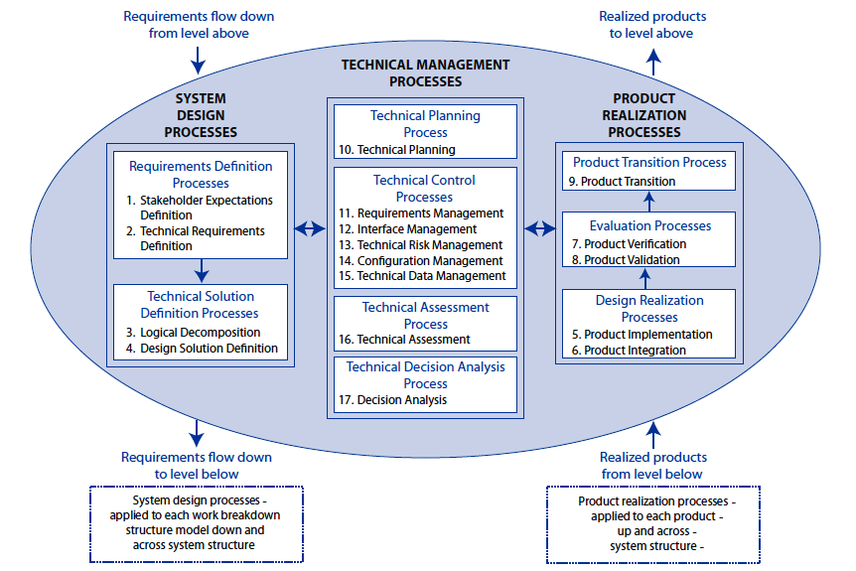
Approach Analogous to NASA Systems Engineering Engine
- NASA Systems Engineering Handbook

Slide 18
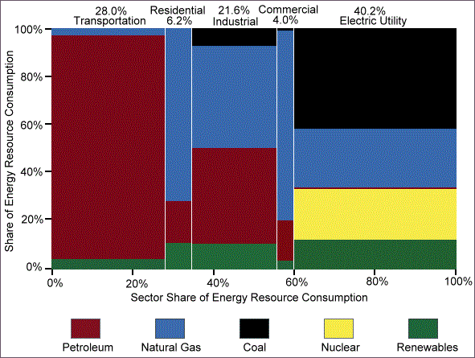
Replace Imported Oil and Reduce Emissions in
Economic Sectors as Required to Achieve Goal
Replace oil in economic sectors from other sources at least 6 MBD
Priority to sector objectives based on oil usage
Priority within sectors to means based on contribution to objective in a decade
Energy Consumption by Sector and Energy Source, 2012
Source: DOE, EERE, Vehicles Technologies Office
18

Slide 19
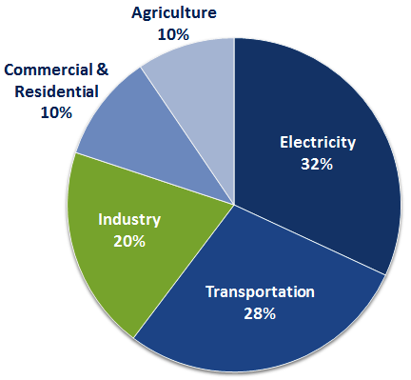
Reduce GHG emissions in Economic Sectors at Least 1,300 MMT
Achieve President Obama’s goal: GHG emission 26-28% below 2005 levels by 2025
Priority to sector objectives based on potential emissions reduction
Priority within sectors to means based on contribution to objective in a decade
Total U.S. Greenhouse Gas Emissions
by Economic Sector in 2012
6,526 Million Metric Tons of CO2 equivalent
Source: All emission estimates from the Inventory of
U.S. Greenhouse Gas Emissions and Sinks: 1990-2012

Slide 20
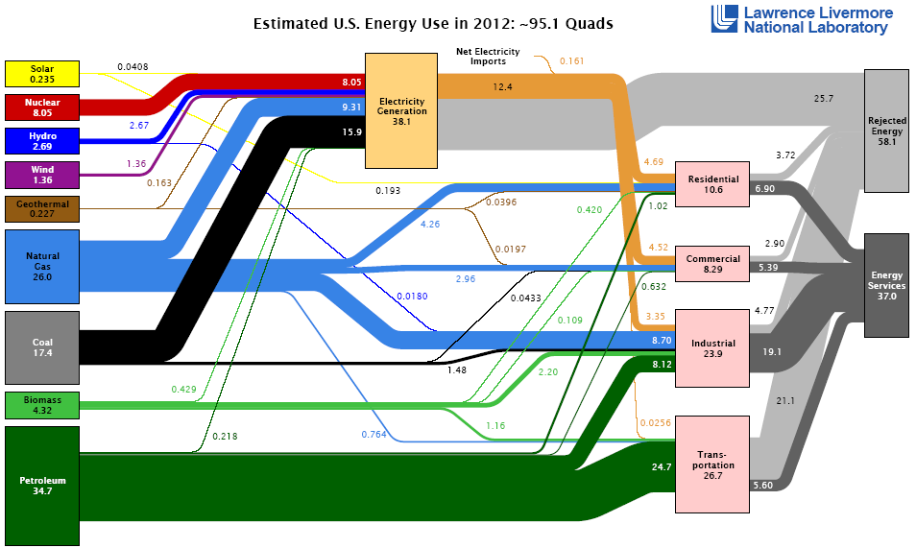
Energy Efficiency Potentially Largest Source of
Energy Production and Emissions Reduction
Rejected energy equal to 58.1% of energy used - Lawrence Livermore National Laboratory
  Burdened cost of energy lost in process that does no productive work
  Priority to each sector based on potential to produce energy and reduce emissions
  DOD has overriding interest and capabilities; could take leadership role
  Waste reduction is life and death to military; dollars and cents to civilians
  U.S Army “Net Zero” Program covering waste, energy and water is a model for cross market development and proves it can be done

Slide 21
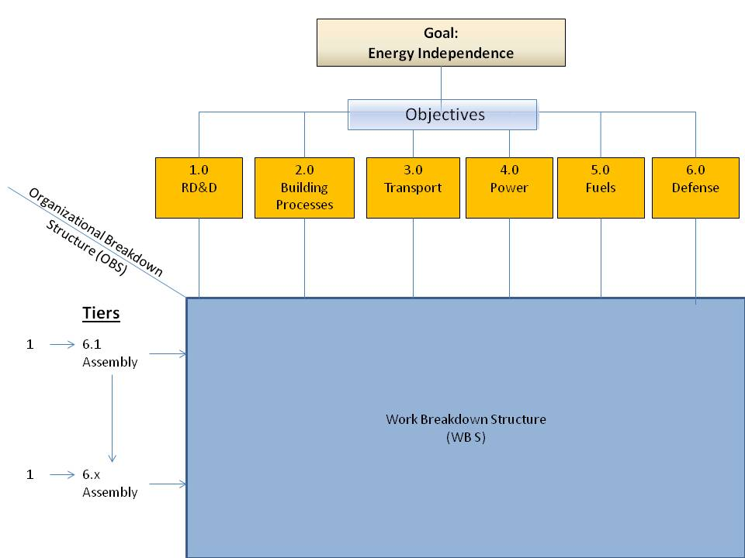
Proposed NEP Program Breakdown Structure
White paper provides goal, objectives, scenarios and methodology
“for discussion purposes” to begin NEP planning project
Scenarios broken down to top level assemblies in white paper

Slide 22
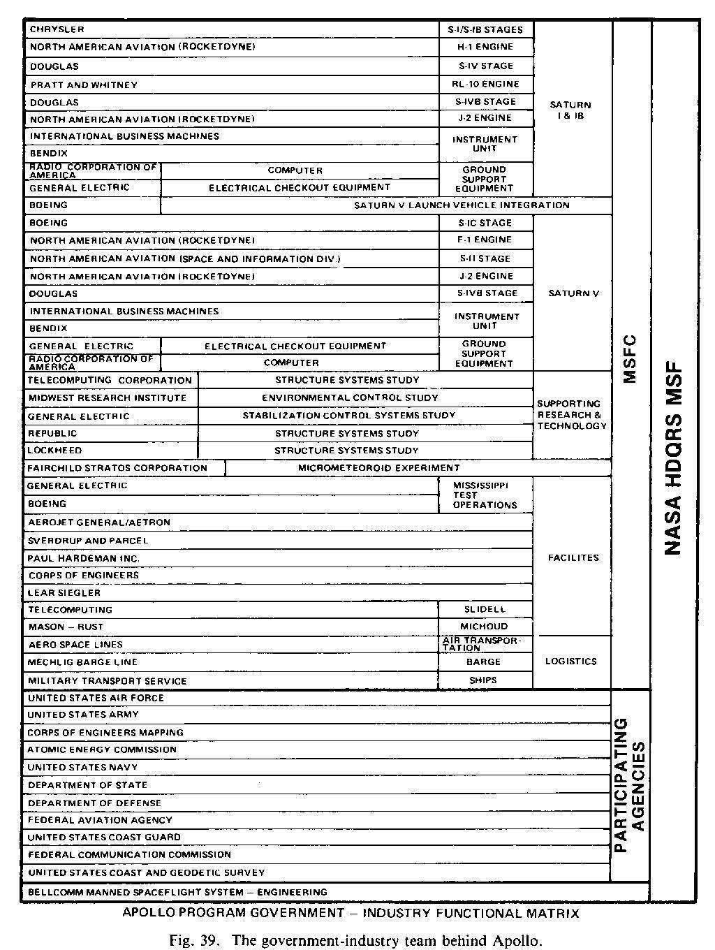
Apollo PBS/OBS
22

Slide 23
NEP Isn’t a One Shot Deal
Build Supply Chains for a Sustainable Energy Future
Example: Transportation Sector Supply Chain
Transportation sector receives top priority based on oil usage
  70% of all the petroleum used in U.S.
  96% of energy used in the transportation sector is oil
  Concentrate on motor vehicles - 59% of oil use in sector for light duty cars and trucks - Blue Print for Securing America’s Energy Future, US Chamber of Commerce
  Other types may be included with support from related industries (Aircraft, Ships, Rail, etc)
What is needed is an integrated, multi-pronged approach that cuts across Administrations
and covers transportation fuels and vehicle
- Fuel Choice for American Prosperity, Institute for the Analysis of Global Security
23

Slide 24

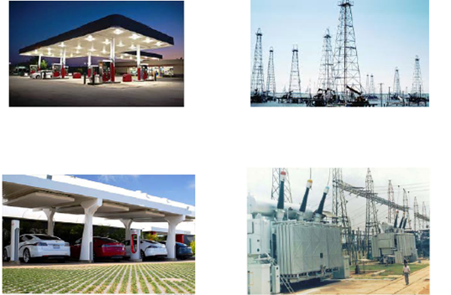

What is Supply Chain Management?
“Cradle to grave” planning, implementation and control of flow of information, materials, products and services from raw material to customer fulfillment and life cycle support and waste reduction/recycling
Supply chain work elements built “down and across” objectives
Transportation Sector Power and Fuels Sectors
Vehicles Customer/System Interface Power/fuels
(Charging/Fueling Stations)

Slide 25
  Planning Transportation Sector Supply Chains
  Priority to means in “rank order” to contribution to sector objective in a decade
Make “apples to apples” comparisons to prioritize each supply chain
  How Much, How Fast, How Clean, What Risk, What Cost?
Gas: CNG uses existing gas production and distribution system
  Gas is “transition fuel” – plentiful, low cost, shorter term
  Need engine conversion, new fueling station network
  Reduces emissions by substituting less polluting means for oil
Electricity: EV’s use existing power grid
  Electricity longer term requires extensive R,D&D
  Need “competitive” vehicle batteries, charging systems and fueling network
  “Buying new” costs more than conversion
  EV’s have range problem
  Eliminates emissions
Liquids: Use existing vehicles and gas station network
  Alternatives “to” and “from” conventional fossil fuels (Biofuels, GTL, CTL)
  Need R&D, new plants, pipelines, freight transportation varies with fuel
  Methanol requires little change in existing system, but has range problem
  Emissions reduction varies by liquid
Hybrids: Transitional vehicles
Other: R,D&D continuous process to bring new technologies to market as they become commercially viable - NEP white paper
25

Slide 26
How Will NEP Operate?
Public/Private Sector Partnership – Not Government Agency
Outside government, freed from political interference and earmarking
  – A Business Plan for America’s Future, American Energy Innovation Council
  Managed by business and military professionals from stakeholder groups
    Brings interests together to expedite R,D&D by means
Must provide real business opportunities, not government supported “Hobby Shops” to secure real business participation to achieve goal
  Hobby Shop: 153,000 gas stations, 20,000 all other fuels in U.S. in 2015 - NGT News
  Example of real business opportunity: Solve “chicken and egg” NGV problem
    NEP brings fleet operators, oil/gas downstream operations, automotive, financial interests together to plan and finance conversion of economic number of vehicles (possibly one million trucks) to support building core national NGV fueling network
    Fueling network to built by large energy producers
    Existing gas station owners within network grid given opportunity to participate
It wasn’t my job to tell industry how to do its job; it was our function to show industry what had to be done and then do everything in our power to enable industry to do it including stepping in if the marketplace couldn't deliver fast enough
- Donald Nelson, Director of the War Production Board, Freedom’s Forge, Arthur Herman

Slide 27
How Will We Start? NEP Planning project
Produce a plan to impact next administration coming into office
  Planning of each objective by stakeholders involved in implementation
    Stakeholders will have incentive to work with constituencies in Congress
  Options
    Government project with assistance from industry, financial sector, universities, national laboratories
    University or think tank project with assistance from government, industry, financial sector, national laboratories.
“Plan B” for energy on separate track from our current track – gridlock
  President Roosevelt’s actions prior to Pearl Harbor an example
    Saw danger and prepared for war on a separate track in a nation living in denial
  Hopefully, NEP won’t require another unforeseen calamity to be implemented
    At a minimum, project will provide planning facility to deal with unforeseen events
    Problems exist that require long term planning that are not be considered national security matters as yet
Project has to start somewhere
  NEP white paper presents a goal, objectives and implementation scenarios “for discussion purposes” to begin the project.
When the evils that arise have been foreseen, they can be redressed, but when having not been foreseen, they are permitted to grow in a way that everyone can foresee them, there is no remedy - Niccolo Machiavelli, The Prince

Slide 28

NEP Planning Project: Coalition of the Willing
Small team sets up project and recruits participants
Stakeholders/participants in project provide funding and in-kind services
Whitewashing the fence
Short list of skill sets for NEP planning project
Supply Chain Management and Logistics (military, civilian)
Program and project management (military, NASA, aerospace)
Investment , Commercial banks, Public finance
Energy business and finance
Accounting
Coal, Oil and Gas industries (strategic planning and operations)
Conventional and alternative automotive industries
Industrial processes equipment and energy systems
Residential, Commercial and industrial buildings energy systems
Utility transmission, distribution systems and regulation
Highways
Solar, Wind, distributed generation
Environmental management, engineering, impact mitigation
Environmental and regulatory law
Universities and think tanks with relevant departments
Illustration from Tom Sawyer
Courtesy The Mark Twain House, Hartford
  “We have found that it is most effective and efficient for us to focus our efforts on established organizations, such as think tanks, universities, business associations, and bipartisan policy groups”
  - Email from William M. Colton, Vice President, Corporate Strategic Planning, Exxon Mobil Corporation

Slide 29
How Will We Educate Leaders of the Future?
Integrate Planning and Operations Studies into Public Policy Education
Education
  Teach “hard skills” not taught in public policy programs to enable students to become competent leaders in today’s increasing demanding environment
    Comparative public, private, military organization; systems engineering; program and project planning and management; supply chain management and logistics; infrastructure economics; management information systems; accounting, finance, etc.
  Courses not found at one institution: integrate courses at multiple institutions
Projects
  Center for developing plans and programs in national interest
  Students work on real world projects, gain experience, build relationships
    NEP planning first project
    Civilian/military interaction in classroom and projects builds understanding/ cooperation
Research and Development
  Develop courses, seminars, briefings and documents to support education program and inform national discourse
  Students participate in R&D
What we do here will only be taught in professional and technical schools
- Dwight D. Eisenhower, Crusade in Europe
Ike didn’t leave a, Strategic Planning for Dummies” book, apparently
- General Ronald Keys, USAF (retired)

Slide 30

Lawrence Klaus began his career as an architect in the offices of Emery Roth & Sons working on projects including working drawings for the World Trade Center. As a research engineer in the Boeing Aerospace Group (ASG) he designed and implemented automated business systems concerned with the design, manufacture, test, delivery, and installation of major military missile, space, and associated programs. He also participated in internal business planning to define ASG program management and information systems capabilities with civilian applications. At Peat Marwick Mitchell (now KPMG) he designed PPB and management and reporting systems for federal government agencies. This included projects such as design of a program planning system for regional plans for the Public Health Service. He founded and was president of Development Management Consultants Inc. and planned and managed company operations on dozens of projects working with utilities, lenders, contractors, non-profit organizations and government. This work included projects such managing local and federal disaster rapid emergency mass home repair. As a manager in the network systems group of Unisys Corporation he worked with company engineers to design networked PC to mainframe systems that integrated company and vendor software and hardware. This included projects such as the user friendly IDEAS online education system for the Air National Guard. As a consultant at Synergic Resources Corporation (now Navigant Consulting) he worked on energy efficiency projects for utilities such as MidAmerican Energy. As an independent consultant has worked on projects related to energy policy, networks and distributed generation. Mr. Klaus holds a B.S, Bachelor of Architecture and M.B.A. from the City College of New York.
  Contact Information
  Lawrence Klaus
  651 E Township Line RD #2121
  Blue Bell, PA 19422
  Phone: 610-631-2190
  Cell: 610-247-3363
  Email: larryklaus1@gmail.com

